Slide 1
Evaluating the Direct, Indirect, and Population-level Effects of LLINs across Transmission Intensities
PhD Update
Zenabu Suboi
26th March 2026

Slide 2
Outline
Introduction
Methods
Results
Key messages and recommendations

Slide 3
Introduction

Slide 4
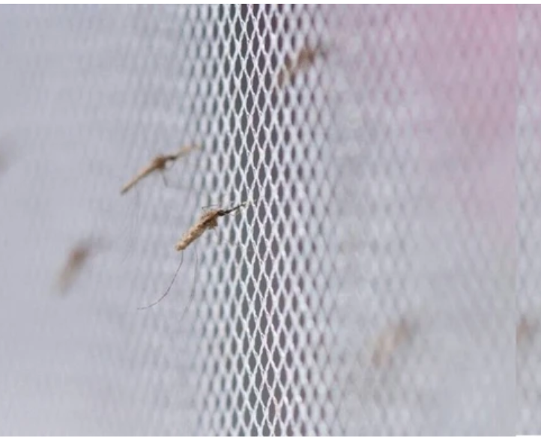
Background – LLIN effectiveness
Long lasting insecticidal nets (LLINs) have been attributed with averting 663 million clinical cases from 2000 – 2015
effectiveness of LLINs arises from two complementary mechanisms:
physical prevention of mosquito bites
insecticidal action that kills or deters mosquitoes

Slide 5
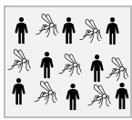
the concept of community protection
LLINs offer different benefits for users and non-users within a population
No LLIN use

Slide 6
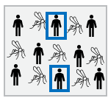
the concept of community protection
LLINs offer different benefits for users and non-users within a population
net-users receive personal protection
No LLIN use
X% LLIN use

Slide 7
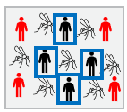
the concept of community protection
LLINs offer different benefits for users and non-users within a population
net-users receive personal protection
both users and non-users benefit from indirect (community) protection
reduced mosquito density, lifespan, and proportion of infectious mosquitoes
This concept has been established as community protection
No LLIN use
X% LLIN use
Increased LLIN use
Notes:
Within OpenMalaria, bed nets act by modifying parameters of the mosquito feeding cycle model.
They reduce host availability,
decrease the probability of successful blood feeding following host contact, and
reduce the probability that a mosquito successfully finds a resting place after feeding

Slide 8
evidence of community protection
Evidence from both empirical and modelling studies
These evidences indicate that
indirect effects are heterogeneous and sensitive to local transmission dynamics, intervention coverage, and vector ecology (eg: EIR 10, 100 – Unwin et al.)
community protection from nets vary by spatial scale and local coverage levels in multiple African settings
Notes:
Western Kenya – EIR~60, [Unwin et al., 2023]
Northern Ghana – EIR100-300,
modeling study -10, 100 [Unwin et al., 2023]
Multi-country DHS analysis – PfPR equivalent to EIR: <20, 20-80, >80

Slide 9
what this study focuses on
the magnitude and reliability of community protection from LLINs remain incompletely evaluated across epidemiological settings
we use OpenMalaria to quantify the direct (user) and indirect (non-user) effects of LLIN usage across a wide range of transmission intensities

Slide 10
Research question
How do the protection offered by LLINs to user, non-user, and the overall population vary across transmission intensity and usage, and what is the optimal coverage window where incremental benefits per additional person protected are highest?
coverage thresholds are required to achieve the same benefits across different transmission intensities?

Slide 11
Methods

Slide 12
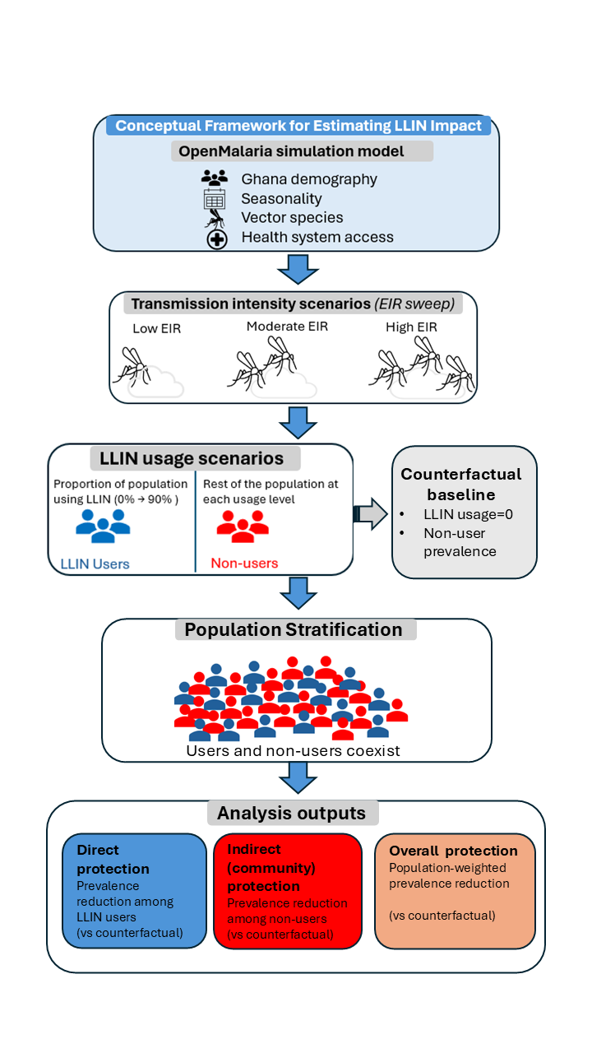
Methods
Notes:
Started from one district in the Oti region of Ghana – Nkwanta South

Slide 13
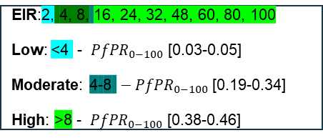
Methods
EIR:2, 4, 8, 16, 24, 32, 48, 60, 80, 100
Low: <4 - ${ PfPR}_{0−100}$ [0.03-0.05]
Moderate: 4-8 ${ − PfPR}_{0−100}$ [0.19-0.34]
High: >8 - ${ PfPR}_{0−100}$ [0.38-0.46]
Notes:
Nobody uses a net in the control scenario, and this is used as the counterfactual to
compare the other scenarios (users and non-users at LLIN usage>0 and different EIR values ) against counterfactual

Slide 14
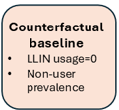
Methods
EIR:2, 4, 8, 16, 24, 32, 48, 60, 80, 100
Low: <4 - ${ PfPR}_{0−100}$ [0.03-0.05]
Moderate: 4-8 ${ − PfPR}_{0−100}$ [0.19-0.34]
High: >8 - ${ PfPR}_{0−100}$ [0.38-0.46]
Cohort Implementation
LLIN users
Non-users
Notes:
In Openmalaria, a cohort is a sub-population which can be monitored separately and can used to target intervention deployment
Nobody uses a net in the control scenario, and this is used as the counterfactual to compare the other scenarios (users and non-users at LLIN usage>0 and different EIR values ) against

Slide 15
Methods
EIR:2, 4, 8, 16, 24, 32, 48, 60, 80, 100
Low: <4 - ${ PfPR}_{0−100}$ [0.03-0.05]
Moderate: 4-8 ${ − PfPR}_{0−100}$ [0.19-0.34]
High: >8 - ${ PfPR}_{0−100}$ [0.38-0.46]
Cohort Implementation
LLIN users
Non-users
Interventions Implemented
CM: 2003-2022
IG2 net: 2023, 2026, 2029
Seed = 10
Pop size: 10’000
Age groups: 0-5, 0-10, 0-100
Notes:
Nobody uses a net in the control scenario, and this is used as the counterfactual to
compare the other scenarios (users and non-users at LLIN usage>0 and different EIR values ) against counterfactual

Slide 16
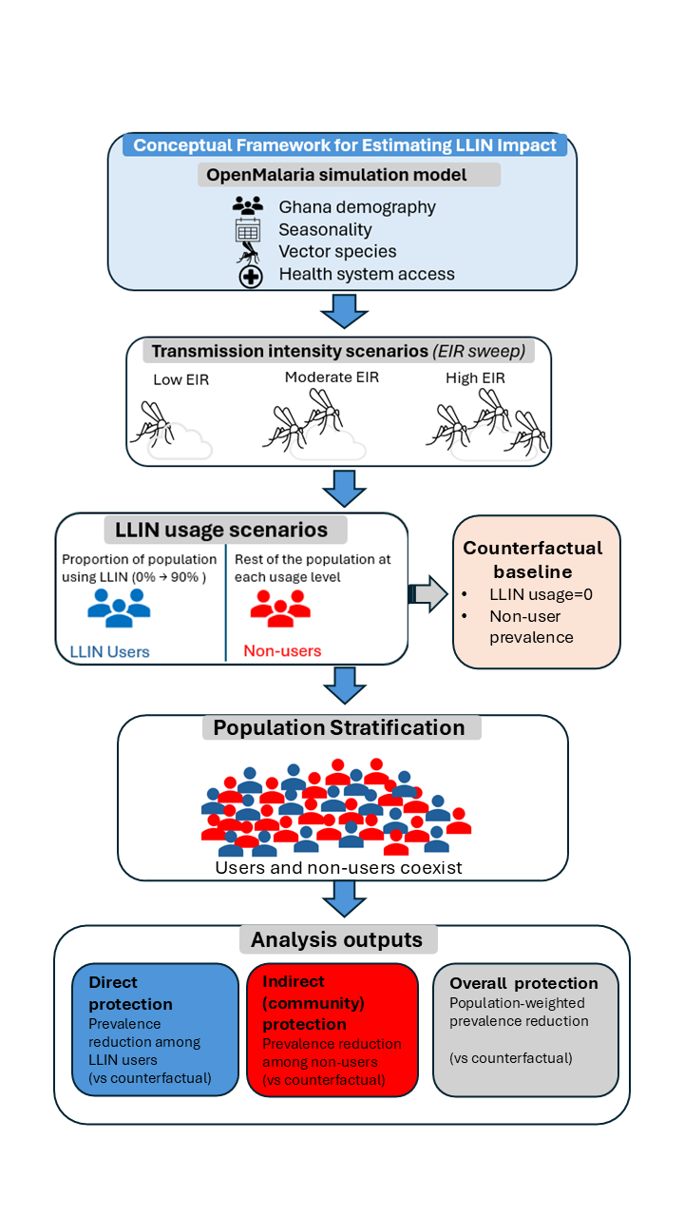
Methods
EIR:2, 4, 8, 16, 24, 32, 48, 60, 80, 100
Low: <4 - ${ PfPR}_{0−100}$ [0.03-0.05]
Moderate: 4-8 ${ − PfPR}_{0−100}$ [0.19-0.34]
High: >8 - ${ PfPR}_{0−100}$ [0.38-0.46]
Cohort Implementation
LLIN users
Non-users
Interventions Implemented
CM: 2003-2022
IG2 net: 2023, 2026, 2029
Seed = 10
Pop size: 10’000
Age groups: 0-5, 0-10, 0-100
Notes:
Nobody uses a net in the control scenario, and this is used as the counterfactual to
compare the other scenarios (users and non-users at LLIN usage>0 and different EIR values ) against counterfactual

Slide 17
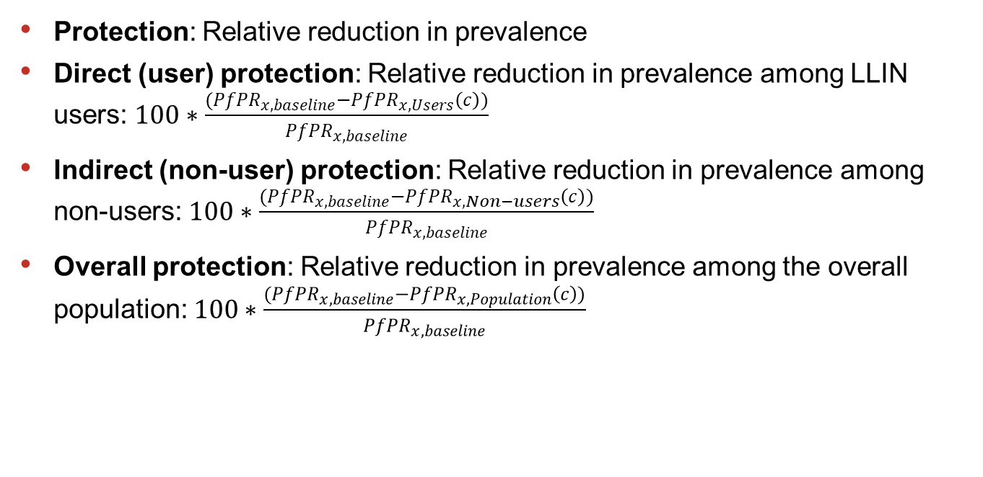
Impact definitions and estimates
Protection: Relative reduction in prevalence
Direct (user) protection: Relative reduction in prevalence among LLIN users: $100∗\frac{({PfPR}_{x,baseline}−{PfPR}_{x,Users}\left(c\right))}{{PfPR}_{x,baseline}}$
Indirect (non-user) protection: Relative reduction in prevalence among non-users: $100∗\frac{({PfPR}_{x,baseline}−{PfPR}_{x,Non−users}\left(c\right))}{{PfPR}_{x,baseline}}$
Overall protection: Relative reduction in prevalence among the overall population: $100∗\frac{({PfPR}_{x,baseline}−{PfPR}_{x,Population}\left(c\right))}{{PfPR}_{x,baseline}}$

Slide 18
Results

Slide 19
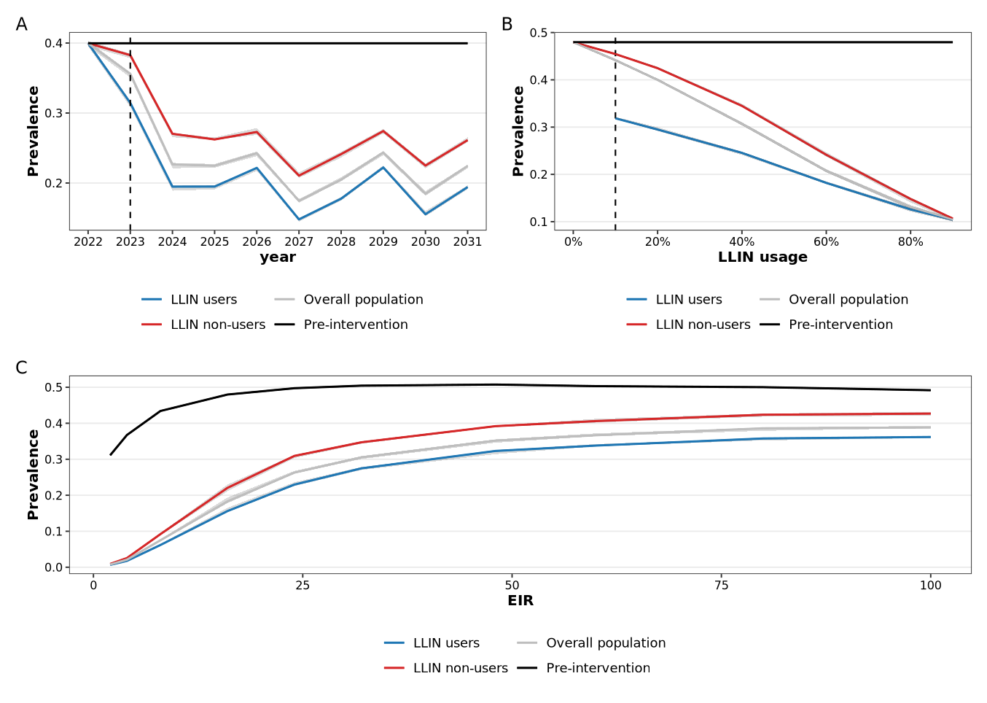
Impact of LLINs on malaria prevalence among population groups stayed constant over time, declined with usage, and increased with transmission intensity
Notes:
A –moderate transmission intensity = averaged across EIRs, at one coverage,
usage = 60%
B - moderate transmission intensity = averaged across EIRs and 3 years
LLIN impact on prevalence averaged across one distribution cycle (2026-2028)
C – prevalence averaged across 3 years - distribution cycle (2026-2028), at one coverage
Usage = 60%

Slide 20
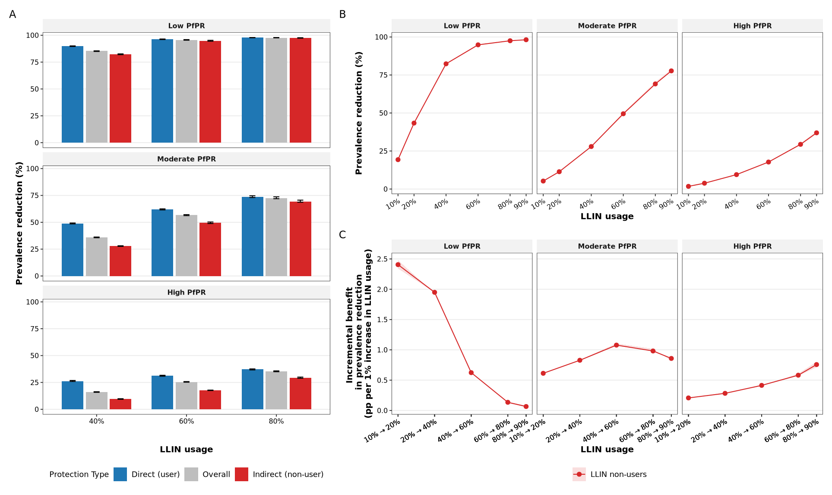
A: Protection increased with increasing usage and decreased with increasing transmission intensity. B: there is a plateau in low PfPR. C:Usage thresholds for incremental benefits increased with increasing transmission intensity

Slide 21
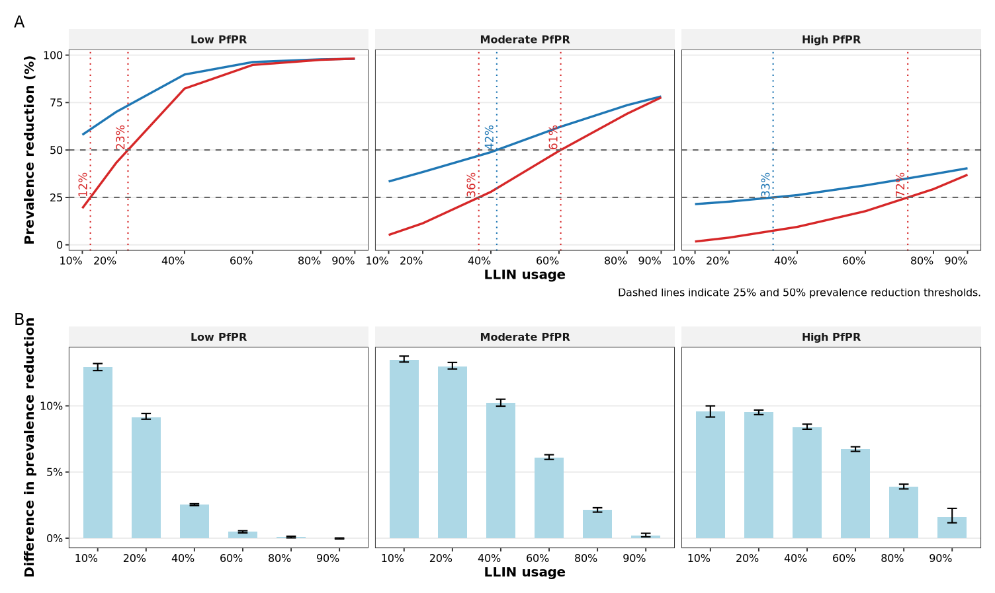
Usage thresholds for predefined levels of protection increase with increasing transmission intensity
Notes:
Coverage thresholds for highest incremental benefits and predefined levels of protection differ across transmission intensities
A –
B –
C - More resources are required to achieve comparable levels of protection as transmission intensity increases

Slide 22
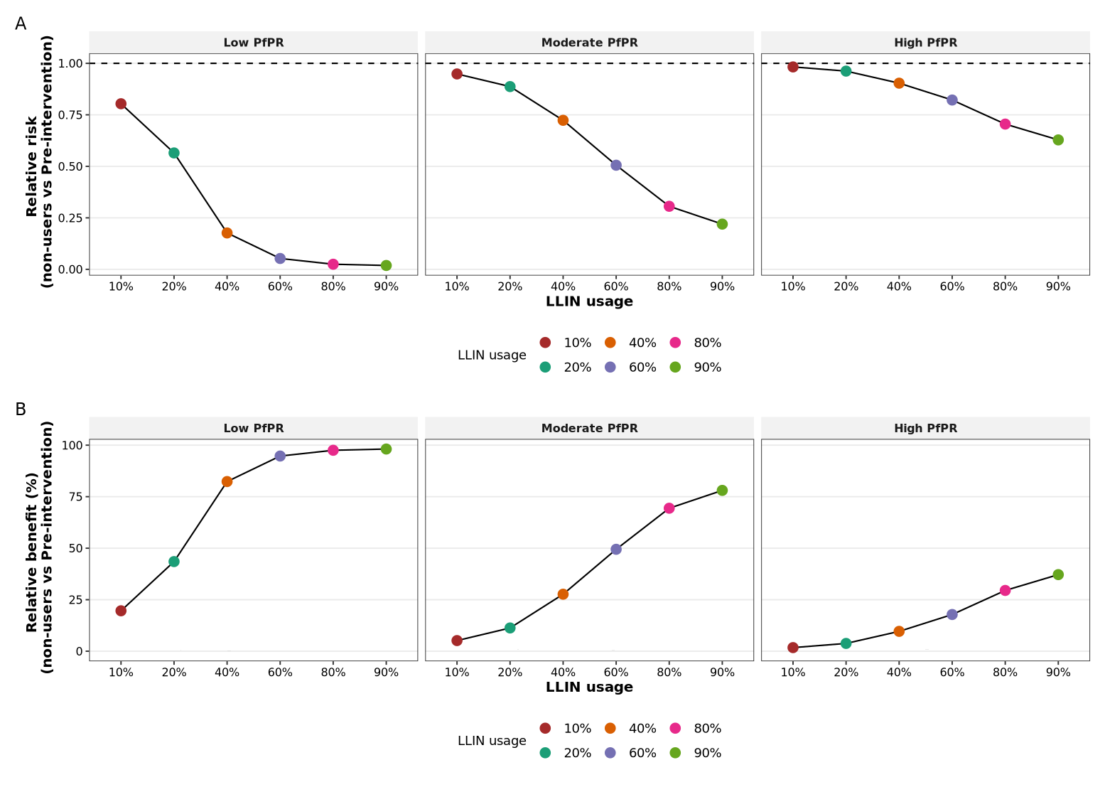
Relative risk and benefit (non-users vs pre-intervention baseline)
A. malaria infection risk among non-users compared to pre-intervention declines with increasing usage, but increases with increasing transmission intensity
B. Relative benefit offered by LLINs to non-users compared to pre-intervention increases with increasing usage, but decreases with increasing transmission intensity
Image caption title.

Slide 23
Key messages
LLIN effects are nonlinear
The disparity in infection risk between LLIN users and non-users decreases with increasing coverage
indirect protection is transmission-dependent.
indirect protection is strongest and most efficient in low-to-moderate transmission settings and becomes harder to achieve as EIR increases
There is a plateau in low but not in moderate to high transmission settings
High EIR settings do not generate strong community effects without very high coverage
Modest coverage (≈ 30%) is required in low EIR settings to achieve 20% reduction in prevalence among non-users, whereas mid-level coverage (≈50–60%) required in moderate EIR settings
Notes:
The magnitude and efficiency of community-level protection from LLINs are strongly transmission-dependent, with substantial indirect effects at low-to-moderate EIR but diminishing returns in high transmission settings, implying that optimal coverage targets must be tailored to baseline transmission intensity.

Slide 24
Recommendations
In low PfPR settings, maintain ≥ 30–50% effective usage to preserve community protection
Push toward ≥ 50–70% to achieve considerable indirect effects in moderate settings
Protect gains in low transmission settings
Do not deprioritize LLINs low-transmission areas
Nets alone are not sufficient in high PfPR settings, combine with other interventions
Use modelling to guide prioritization under budget constraints

Slide 25
Thank you for your attention

